Slide 1


Analysis of Safeguarding Adult Reviews:
April 2017 - March 2019
Authors: Michael Preston-Shoot, Suzy Braye, Oli Preston, Karen Allen and Kate Spreadbury

Slide 2

The Background
First national analysis of Safeguarding Adult Reviews (SARs)
Purpose was to identify priorities for sector-led improvement.
Analysis fills a significant gap in the knowledge base about adult safeguarding across all types of abuse and neglect
98% SABs (129/132) responded to requests for published and unpublished reviews completed between 1 April 2017 and 31 March 2019
In total 231 SARs are included in the analysis

Slide 3
Types of Abuse and Neglect
Type of Abuse/Neglect | SARs n | Per cent | Type of Abuse/Neglect | SARs n | Per cent
Self-Neglect | 104 | 45% | Sexual Abuse | 12 | 5%
Neglect | 85 | 37% | Sexual Exploitation | 5 | 2%
Physical Abuse | 45 | 19% | Modern Slavery | 2 | 1%
Organisational Abuse | 33 | 14% | Discriminatory Abuse | 2 | 1%
Financial Abuse | 30 | 13% | Other | 11 | 5%
Domestic Abuse | 22 | 10% | Not Specified | 29 | 13%
Psychological Abuse | 19 | 8%

Slide 4

Cases cont.
A range of health concerns were reported, the most common being mental health and chronic physical conditions
The most common living situations were living alone (36%) and in group care (33%)
The most common location for the abuse/neglect was the person’s own home (48%), followed by residential/nursing care (18%)
The most common perpetrator of abuse was ‘self’ (48%), followed by care providers (30%)
Few SARs provided information about, or analysed, the impact of sexuality and ethnicity

Slide 5
Themes and Recommendations – Direct Practice
Top Good Practice Themes | n | Top Poor Practice Themes | n | Top Recommendation Themes | n
Responding to Health | 56 | Mental Capacity | 138 | Risk Assessment | 72
Personalisation | 53 | Risk Assessment | 134 | Mental Capacity | 64
Continuity | 37 | Safeguarding | 115 | Working with Caregivers | 62
Care/Support | 36 | Working with Carers | 111 | Care/Support | 56
Safeguarding | 32 | Care/Support | 110 | Personalisation | 47
Mental Capacity | 32 | Responding to Health | 99 | Responding to Health | 45

Slide 6
Themes and Recommendations -Interagency Working
Top Good Practice Themes | n | Top Poor Practice Themes | n | Top Recommendation Themes | n
Information-Sharing | 53 | Case Coordination | 168 | Case Coordination | 126
Case Coordination | 45 | Information-Sharing | 162 | Information-Sharing | 96
Safeguarding | 37 | Safeguarding | 115 | Safeguarding | 76
Legal Literacy | 5 | Procedures | 53 | Procedures | 54
Record Sharing | 3 | Legal Literacy | 44 | Record Sharing | 27

Slide 7
Themes and recommendations-Organisational Features
Top Good Practice Themes | n | Top Poor Practice Themes | n | Top Recommendation Themes | n
Management Scrutiny | 10 | Staffing/Workloads | 64 | Training | 90
Commissioning | 6 | Management Scrutiny | 63 | Commissioning | 65
Specialist Advice | 4 | Training | 54 | Quality Assurance | 48
Staff Support | 4 | Resources | 49 | Policy/Procedures | 42
Quality Assurance | 4 | Commissioning | 49 | Records/Recording | 38

Slide 8
Themes and Recommendations - SAB Governance
Top Good Practice Themes | n | Top Poor Practice Themes | n | Top Recommendation Themes | n
SAR Management | 3 | Self-Neglect Policy | 15 | Learning Dissemination | 75
SAB Procedures | 2 | Escalation Policy | 14 | Quality Assurance | 50
Learning Dissemination | 1 | Risk Policy | 9 | Training | 39
Membership | 1 | SAR Management | 9 | Self-Neglect Policy | 34
Training | 1 | M/Capacity Policy | 8 | Other Procedures | 33

Slide 9


National Legal and Policy Context
Less than one quarter of SARs in this analysis made reference to this context: for example, to the impact of financial austerity on the range of services available and on the increasing number and complexity of cases referred to practitioners.
SARs missed opportunities to highlight where other reviews have focused on similar concerns, such as abuse in closed institutions, and where revisions to the legal rules and/or national policy could strengthen adult safeguarding provision.
Notes:
There is concern that SARs have given insufficient attention to this domain, even though practice and policy locally are profoundly shaped and influenced by the national legal, policy and financial context within which they are situated

Slide 10


Sector-Led Improvement Priorities – SAB Commissioning and Conduct of SARs
SABs should review their record-keeping to ensure that completed SARs remain in the collective memory, available as a baseline for measuring subsequent change
SABs should be asked to provide reassurance that partner agencies understand the relevant legislation regarding referral and commissioning of SARs
Regional and national SAB networks to review approaches to the interpretation and application of section 44 Care Act 2014 in decision-making about SAR referrals
Notes:
There are five main categories for sector led improvement priorities. I’ve picked out two, focussed on SAB practice in the commissioning and conduct of SARs and support for adult safeguarding practice improvement

Slide 11


Sector-led Improvement Priorities – SAB Commissioning and Conduct of SARs cont.
SABs should review their governance procedures for SARs and ensure that referrals and decision-making are timely, with meeting minutes and reviews clearly noting the reasons for positive or negative delay
SABs should review their reporting of SARs in annual reports to ensure compliance with the requirements of statutory guidance and the imperatives that learning is embedded, and the impact and outcomes of reviews evaluated
SABs should review their approach to ensuring the quality of reports
Terms of reference for all SARs must include consideration of how race, culture, ethnicity and other protected characteristics as codified by the Equality Act 2010 may have impacted on case management

Slide 12


Sector Led Improvement Priorities - Support for Adult Safeguarding Practice Improvement
Briefings should be published for practitioners and managers on the implications for best practice in adult safeguarding of the requirements of the Equality Act 2010
Direct work with adults at risk: SABs should review how they seek assurance on practice standards and contribute to improvement, working to the priorities in the main report.
Interagency working: SABs should review how they seek assurance on standards of interagency practice and contribute to improvement, working to the priorities in the main report

Slide 13
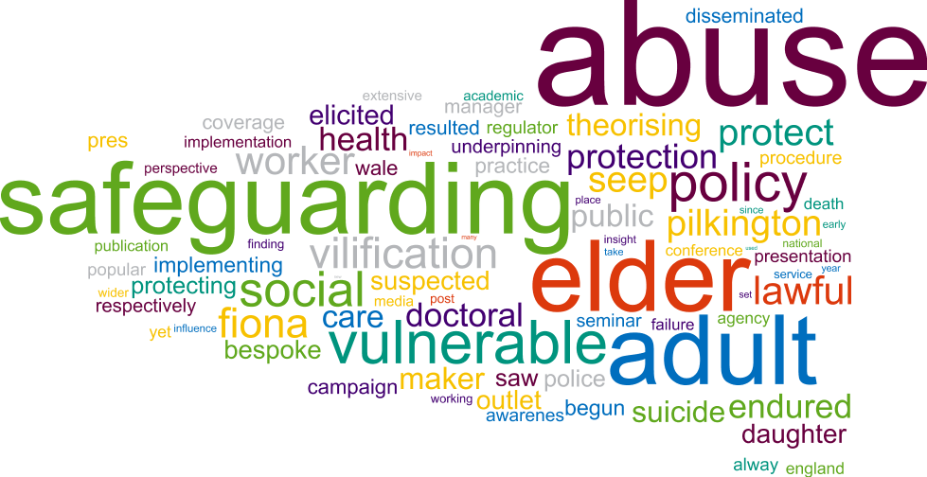
Sector Led Improvement Priorities - Support for Adult Safeguarding Practice Improvement cont.
Organisational Features: SABs should review how they seek assurance on organisational systems, culture and resources, and contribute to improvement across their partnership, working to the priorities set out in the main report.
Given the consistency of recommendations in SARs, which replicate those made in earlier reviews, SABs should review how they seek assurance on practice standards and contribute to service and policy improvement and enhancement across their partnerships.

Slide 14

Key Questions for SABs
How has SAR quality been assured?
How has the SAB captured the outcomes of action taken to implement SAR recommendations?
Are we making sufficient use of the available evidence from SARs and from research when analysing the facilitators that enhance and the barriers that impede good practice?
Are we learning what still needs to be achieved locally and nationally to provide the best context for preventing and protecting individuals from different types of abuse and neglect?

