Slide 1
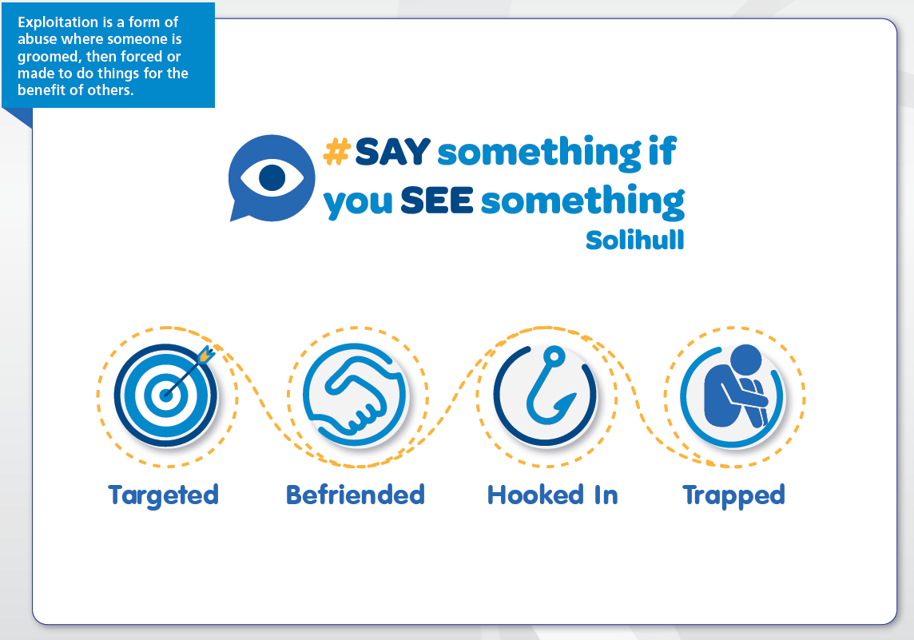
Exploitation training for Hotels,
B & B’s etc. in Solihull
Notes:
As you introduce this training it is wise to make people aware that they may find this quite emotive, and that on hearing the information it may bring things to their attention; things that may have happened to them or people they know.
It’s wise to let people know that they can leave the training if they need to, and who they can speak with if they have any concerns; this may be their manager, an experienced colleague, employee assist services, or they may wish to call the local services listed on the power point.

Slide 2

• In Solihull, we believe that local businesses & employees can play a positive role in preventing Exploitation and human trafficking, which puts children and adults (and your business/place of work) at risk!
• Your business can specifically form a crucial part of the fight against these issues and be the eyes and ears of the community, providing potentially important information to authorities.
• By working together we can play a positive role in protecting children, vulnerable adults and local businesses.

Slide 3
Exploitation is a form of abuse where someone is groomed, then forced or made to do things for the benefit of others.
An abuser may manipulate the person to think that they are their friend, or even a boyfriend or girlfriend. But they will put them into dangerous situations, forcing them to do things they don’t want to do. The abuser may physically or verbally threaten the person or be violent towards them. They will control and manipulate them, and try to isolate them from friends and family.
Sexual Exploitation
Criminal Exploitation
Modern Slavery
Trafficking
Notes:
Sexual exploitation is sexual abuse. It happens when a child(under 18) or an adult is encouraged, or forced, to take part in sexual activity in exchange for something.
The reward might be presents, money, alcohol, or simply emotional attention.
It can happen to any child or person.
It might seem like a normal friendship or relationship to begin with.
It can happen online or offline, and without the child/ person being aware of it.
Criminal exploitation happens when victims are being forced into activities such as, shoplifting and pickpocketing, cannabis cultivation, drug dealing and financial exploitation.
Those being exploited are often under the control of highly organised criminals, although they may not realise this
Criminal exploitation activity is sometimes referred to as ‘county lines’ a term used to describe gangs and organised criminal networks involved in exporting illegal drugs into areas within the UK, using dedicated mobile phone lines or other form of “deal line”. If you have access to WiFi you may wish to show this video clip- https://www.youtube.com/watch?v=DdYq2dhQ3qc
They are likely to exploit children and vulnerable adults to move and store the drugs and money and they will often use coercion, intimidation, violence (including sexual violence) and weapons
These are both examples of Modern Slavery and crimes under the Modern Slavery Act 2015

Slide 4
Human Trafficking
People who are exploited are also vulnerable to human trafficking.
Human trafficking can involve recruiting, transporting, transferring, harbouring or receiving a person for the purpose of exploitation or abuse.
Trafficking within the UK is an offence irrespective of distance travelled and can be applied to movements within the same street.
Human Trafficking is an offence under the Modern Slavery Act 2015.
Notes:
Many people think that to be a victim of trafficking you have to travel from one country to another; this is not the case, trafficking takes place if someone is recruited, transported, transferred, harboured or received for the purpose of exploitation, so even someone making a phone call to arrange for something to happen where another is exploited, although not actually physically moving that person themselves, they may have committed a trafficking offence by recruiting someone for the purpose of exploitation.
Victims of trafficking are often made to commit crimes, and this is used as a threat that they will be in trouble with the police if they get caught; however there are legal guidelines that can prevent this from happening.

Slide 5
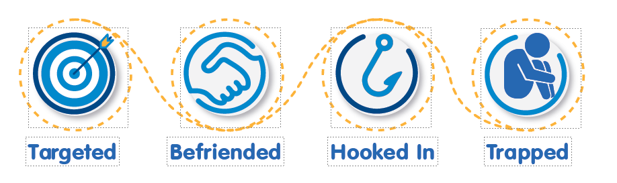
Look out for;
People who regularly visit and spend time watching others, looking out for people who appear isolated, vulnerable, in need of attention, or under the influence of alcohol or substances.
Guests requesting isolated rooms.
Guests with local address renting rooms regularly
Last minute walk ins- especially if 1 person is under the influence of substances/ alcohol
Look out for;
Guests who don’t seem to know each other well, but booked in the same room.
Guests who try to conceal activities in their room; i.e. they don’t want their room cleaned.
Alcohol orders to rooms where guests appear under age
Frequent visitors to the property who have not booked themselves
People flashing large amounts of cash, refusing to give credit card details
Look out for;
People who look scared or intimidated, by the people they are with.
People who display volatile or criminal behaviour, theft or vandalism.
Signs of extreme sexual activity in a room; lots of condoms, drugs paraphernalia etc.
Guests avoidant of staff interaction; leaving at unusual hours
Look out for;
People who are told what to do by others, are unable to make choices for themselves or move around unobserved.
People who speak on behalf of the person they are with.
People who are threatening and violent towards others.
Same vulnerable/ young person visiting with multiple others .
People who are selling illegal substances
Notes:
The images at the top of this screen portray the ‘grooming line’ grooming is a technique used by those who exploit to manipulate their way into someone’s life. At some point the person will be extremely nice to the person they wish to exploit, to gain their trust, but this can very rapidly change to being very threatening & physically/ sexually violent. Working in an environment where people come to socialise means that you are ideally placed to look out for concerning behaviours, some of which are outlined here, in group discussion you may be able to identify more.

Slide 6
Offenders will also try to groom protective adults and the environment.
This can mean:
They may look to gain employment in places where they can groom
They may look to groom employees in places where they wish to target
They will appear to be able to provide credible responses for their actions to people in places they are targeting
Notes:
Unfortunately some people will try and get themselves into positions where they have more chance to meet and exploit those who are vulnerable, they may well take advantage of the facility they work to do this- offering free food, drinks, etc. Alternatively they may groom people that work in these places, using their position to help them exploit vulnerable people. This may look like they are friendly, show support to employees; leave large tips, and build empathy; they may step in to a staff members defence if someone else is raising a complaint.
We have to be prepared to raise questions about working colleagues as well as people visiting if we have concerns. People who exploit others can appear very charming, this is how they are able to exploit others; they are always prepared and able to provide credible responses for their actions to win people over, especially if these people are work colleagues, in the places they are targeting.

Slide 7
The law means we all have a role to play in preventing exploitation:
Sexual Offences
Misuse of Drugs
Child Abduction
Modern Day Slavery and Trafficking
GDPR/ Information Sharing
Licensing
Health and Safety
Offensive Weapons
Notes:
There is lots of legislation that our employers require us to follow in the work place, some we may be more familiar with than others, but all of the points mentioned here are covered within legislation that applies to us all but is very relevant to preventing exploitation, so we have a legal duty to safeguard people and to do everything we can to prevent exploitation taking place.

Slide 8
Risk Management
It’s important to take all reasonable steps to protect children and vulnerable adults from exploitation and trafficking so you need to have robust safeguarding systems in place. For example:
Always check ID & only accept photo ID (passport, driving licence or PASS logo) & make sure someone else isn’t booking for someone under-age.
Encourage staff to be vigilant, to enquire about things that appear to be suspicious, even if this is a colleague, and record & report any concerns.
Have a single point of contact for safeguarding concerns.
Create links with neighbouring venues and co-ordinate awareness of concerns.
Notes:
As employees you will need to know what is expected of you in your role and where to go if you have any safeguarding concerns
If possible at this point facilitate discussions within teams to enable people to agree how this will work in their work place – use the things to look out for from the grooming line power point to think about places in the setting that may be of more concerns and localised processes for agreeing who is the central point of contact & how as a team they will record & respond if they see something of concern- the next power point has the contact numbers for local services.

Slide 9
What to do
Speak to your Supervisor / Manager / Safeguarding Lead
Call the Police – 101 or in an emergency 999
Download and secure any CCTV
Record any relevant details- descriptions of any potential offenders / victims
Identify methods of payments i.e. cash / credit / debit cards
Call Crimestoppers on 0800 555 111
Call 0121 704 8021 for support for anyone who is being exploited
Notes:
If you are suspicions of any activity that may suggest exploitation these are the actions you can take

Slide 10

Further information
https://crimestoppers-uk.org/
www.thinkuknow.co.uk
www.stopitnow.org.uk
NSPCC ChildLine 08001111 Missing People: https://www.missingpeople.org.uk/get-help/help-services/exploitation-and-county-lines/what-is-county-lines
Parents Against Exploitation (PACE): https://paceuk.info/
The St Giles Trust https://www.stgilestrust.org.uk/what-we-do?gclid=EAIaIQobChMIve2NybXf7gIVJe_tCh2haQcpEAAYASAAEg KR2fD_BwE
National working group http://www.nwgnetwork.org/
CEOP https://www.ceop.police.uk/
West Midlands anti-slavery network https://westmidlandsantislavery.org/support-available-to-survivors/
Notes:
It is everyone's responsibility to say something if you see something, we want Solihull to be a safe place for everyone, but that can only happen if everyone works together to make it happen.
The websites on this page provide further information and support.

