Slide 1
Solihull Safeguarding Practice Learning Forum
Wednesday 24th January 2024

Slide 2
Agenda
SSCP updates
SSAB updates
Think Family Exercise
Birmingham & Solihull Mental Health Foundation Think Family Initiative

Slide 3
SSCP Updates
Early Help Strategy Launched November 2023 recording available https://www.safeguardingsolihull.org.uk/lscp/multi-agency-procedures-and-practice-guidance/early-help/
Family Hubs & early Help Networking Events
Neglect Tools
SSCP Neglect Continuum of Tools
Chronologies
Multi-agency Chronology Template
Multi-agency Chronology Guide
Screening Tool
Neglect Screening Tool
Neglect Screening Tool Guide
Dispute Resolution/ Escalation Procedures – the process to be followed when there is disagreement between professionals about a case.
Professionals' Case Meeting - should be used by multi-agency professional groups to support reflection and promoting successful outcome of the Early Help/ Child In Need or Child Protection Plan.
Working Together 2023 https://assets.publishing.service.gov.uk/media/65803fe31c0c2a000d18cf40/Working_together_to_safeguard_children_2023_-_statutory_guidance.pdf

Slide 4
SSCP Training
Virtual Training - An introduction to safeguarding for voluntary & community sector organisations | 27.2.2024 | Missing- Welfare Return Interviews | 7.3.24
Module 1 Early Help | 23.1.24 | Module 6 - Neglect: Impact on child development | 7.2.24
Module 1b Early Help- Recognising and supporting parents in parental conflict | 8.2.24 | Module 6(b) - Domestic Abuse | 20.2.24
Module 2 - Child Protection: An introduction to multi-agency working | 25.1.24, 21.02.24, 19.03.24 | Module 6.4 Understanding And Responding to Perpetrators of Domestic Abuse | 6.3.24
Module 3 - Child Protection: The challenges of multi-agency working | 28.2.24 | Module 6(c) – Neglect: The Graded Care Profile 2 | 13.3.24
Module 4 - Child Protection: Analysis, judgement and leadership in partnership working | 5.3.24 | Module 6 (d) Substance misuse | TBA
Module 5 - All Age Exploitation Awareness | 1.2.24 | Module 7 - Physical Abuse: Impact on child development | 1.2.24
Module 5.1 Virtual training - an introduction to contextual safeguarding | 6.2.24 | Module 8 - Emotional Abuse: Impact on child development | 31.1.24
Module 5.2 Virtual training- Parents as partners in tackling child exploitation (CE): Working with and supporting parents affected by CE | 22.2.24 | Module 9 - Sexual Abuse: Impact on child development | 30.1.24 & 20.3.24
Module 5.3 Including contextual safeguarding in individual assessments | 29.2.24 | Managing Allegations against Staff | 12.3.24

Slide 5
SSAB Updates Local News Hidden Harms Video Link to Hidden Harms Video
Dispute Resolution & Escalation Procedure Link to Dispute Resolution and Escalation Procedure
National News
Learning from Safeguarding Adult Reviews Link to Eileen Dean SAR Resources and Link to Joshua SAR Resources
The Experiences of Former Carers – Carers UK Click here to read the report in full
National Partnership Agreement: Right Care, Right Person Click here for the full report
Equality, Diversity & Inclusion
What is Intersectionality? What is intersectionality? - YouTube
Adultification Bias End Adultification Bias (Full Version) - YouTube
Making Safeguarding Personal
Hospital Passports
Orange Button Community Scheme

Slide 6
SSAB Training
Course | Date | Time | Link to Book
Professional Curiosity | Tuesday 13th February 2024 | 10:00am – 1:00pm | Professional Curiosity Registration, Tue 13 Feb 2024 at 10:00 | Eventbrite
Cultural Competency | Monday 26th February 2024 | 10:00am – 3:00pm | Face to face at Sans Souci
Working with People that Self-Neglect | Tuesday 5th March 2024 | 10:00am – 1:00pm | Working with People that Self-Neglect Registration, Tue 5 Mar 2024 at 10:00 | Eventbrite

Slide 7
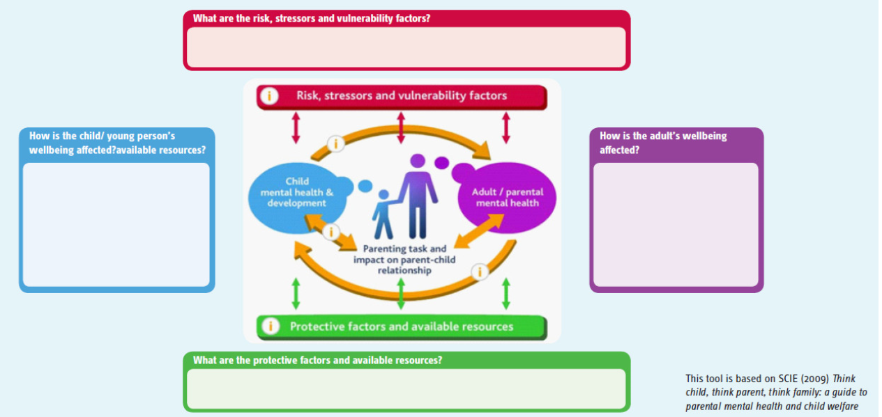
Think Family
Sam’s Story – Child Neglect by a Vulnerable Adult – Real Safeguarding Stories

Slide 9
Trust Think Family Approach and The National Child Safeguarding Practice Review
Outcome of review
Renewed focus needed – for children and families

Slide 10
Why did we develop the Trust Think Family Standard?
Communicating a ‘Bottom Line’ – This is our Trust Offer
Supports assurance process – regulatory compliance
Link to Safeguarding Policy
Ensuring Trust Teams can reflect on practice and identify areas to celebrate and areas to develop
For professionals to reference in revalidation processes

Slide 11
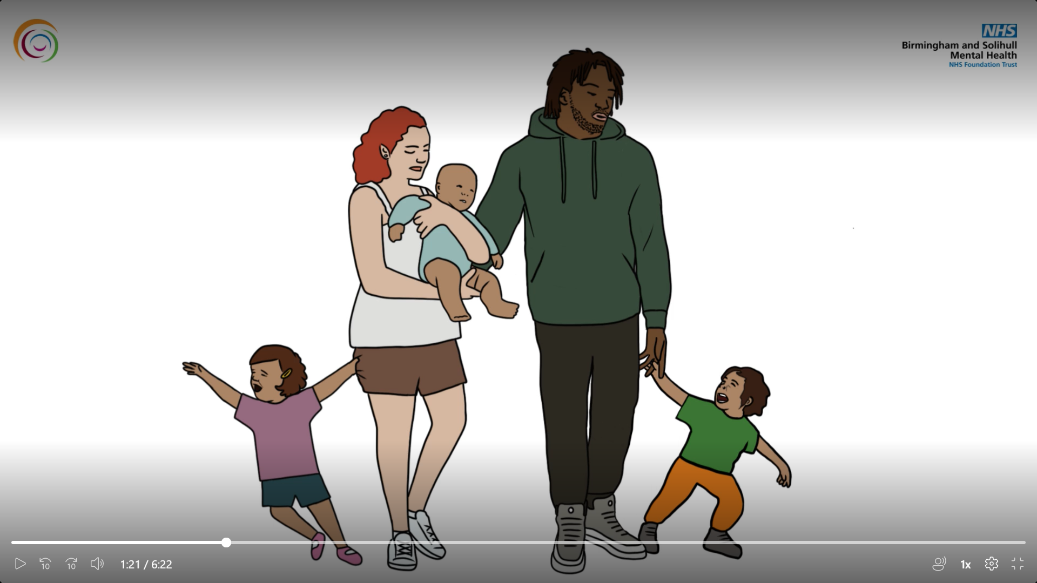
Why did we develop the Think Family Standard?
Use to measure competency and identify CPD needs of teams
To support the process of annual development review
To incorporate and to reference in safeguarding supervision
To support the process of induction

Slide 12
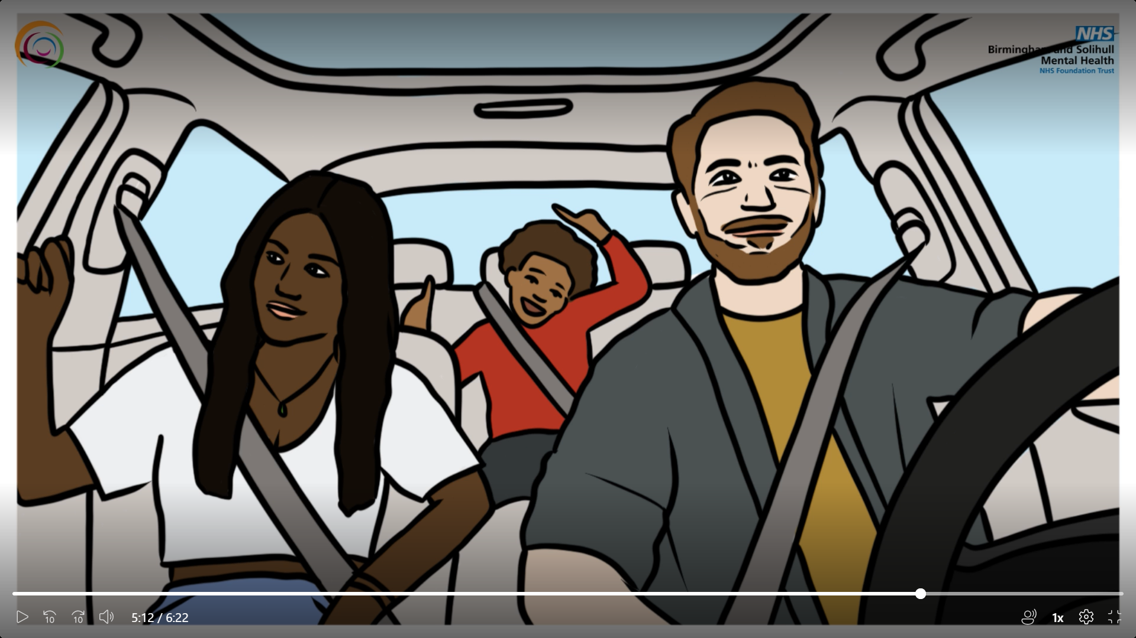
Our service users should be able to say :
“I am a partner in meeting the needs of my family and keeping them and myself safe along with Trust staff and other professionals.”

Slide 14
Think-Family-Safeguarding-Standard-BSMHFT.pdf (safeguardingsolihull.org.uk)

